Slide 1
How to deploy a database with Mongo Atlas

Slide 2
Create a new Organization
You only need to do this once

Slide 3
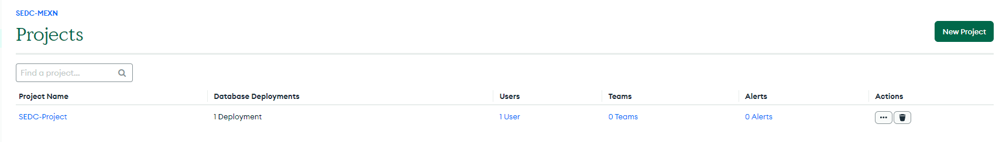
Create a project
Click on the [New Project] button and choose a name.

Slide 4
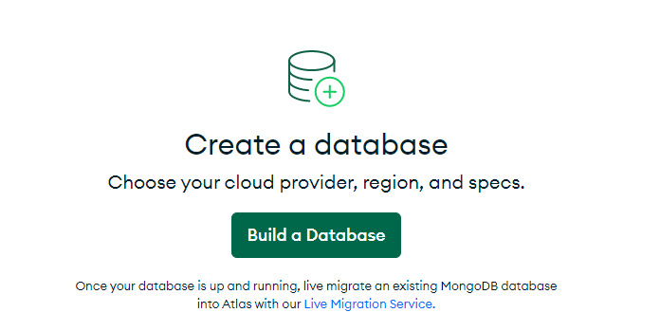
Create a database
Choose the free (most right) tier. Then click create cluster.
You can also change the name of the cluster.

Slide 5
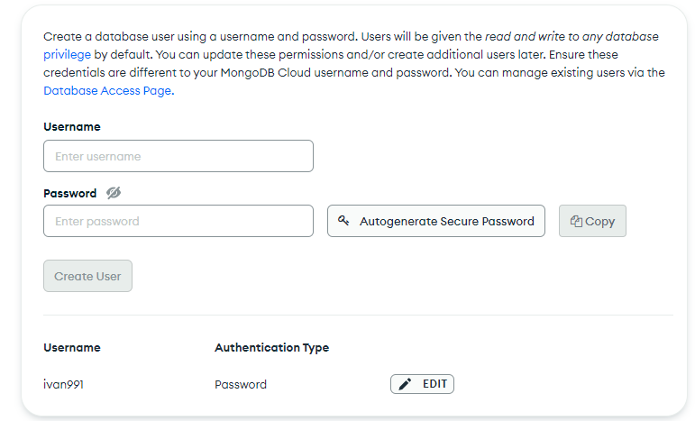
Create a user to connect to the database

Slide 6
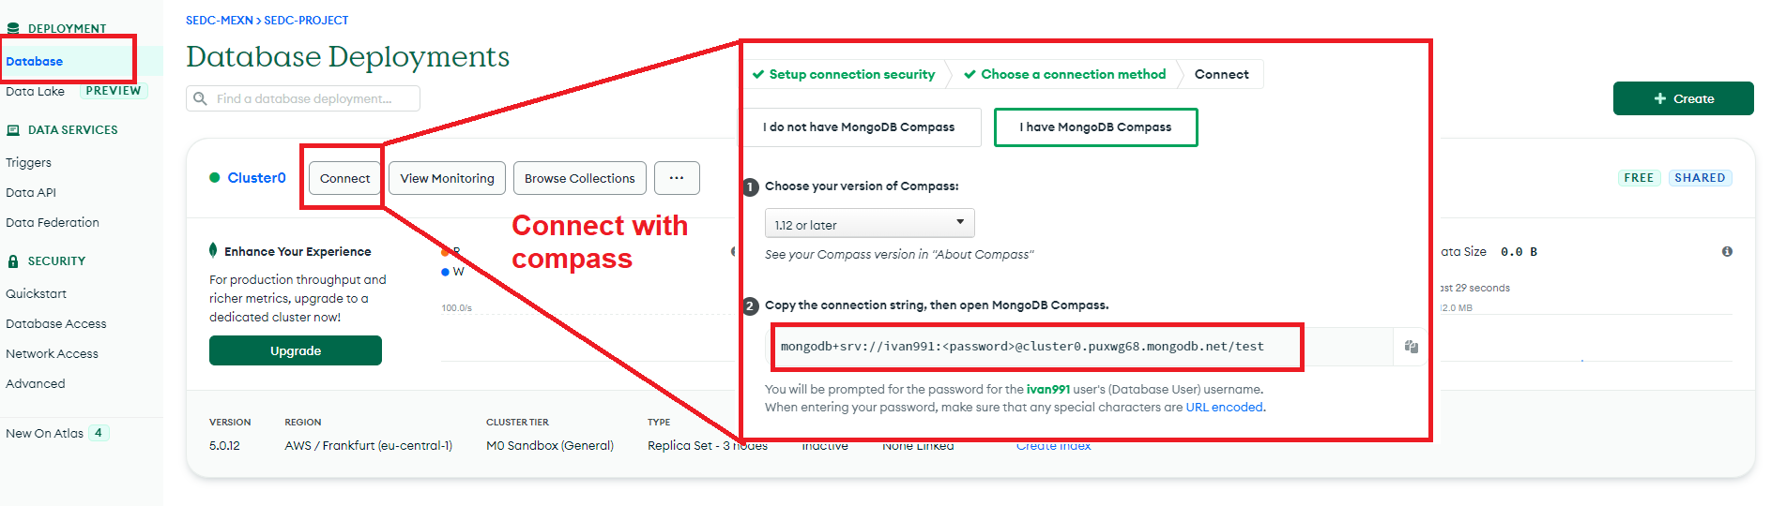
Create a connection to the database
Use the connection string both in Compass and the shell.
Replate <password> with your connection user password

